Slide 1
“IV Kraljevacki bataljon”
My school magazine

Slide 2
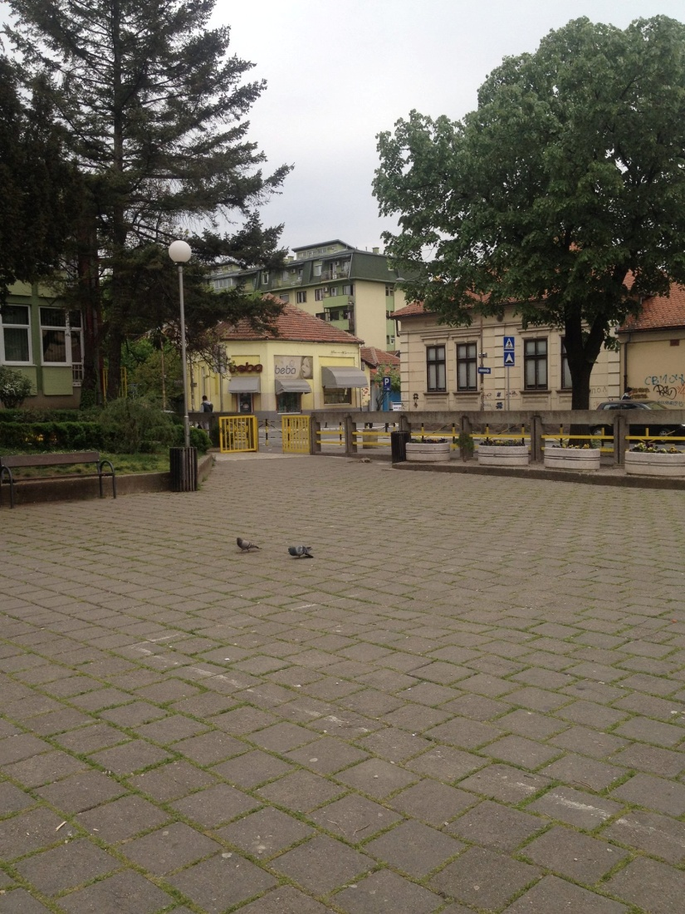
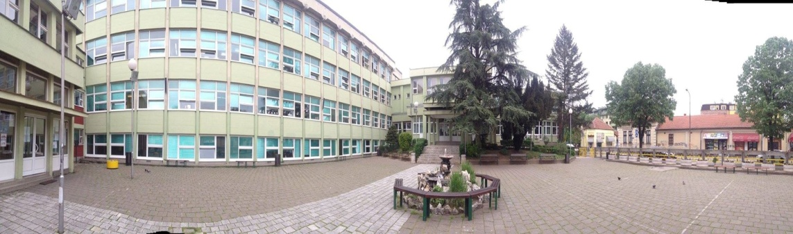
This is the main entrance to the school yard
The main yard is surrounded by a concrete fence. There are big trees around the yard which make the school look really nice. A nice fountain with benches stands in the middle of the yard. During the breaks, everyone spends their time in the yard sitting and talking or playing around. There is also a small sweet shop called Slatki Dom on the other side of the street.

Slide 3
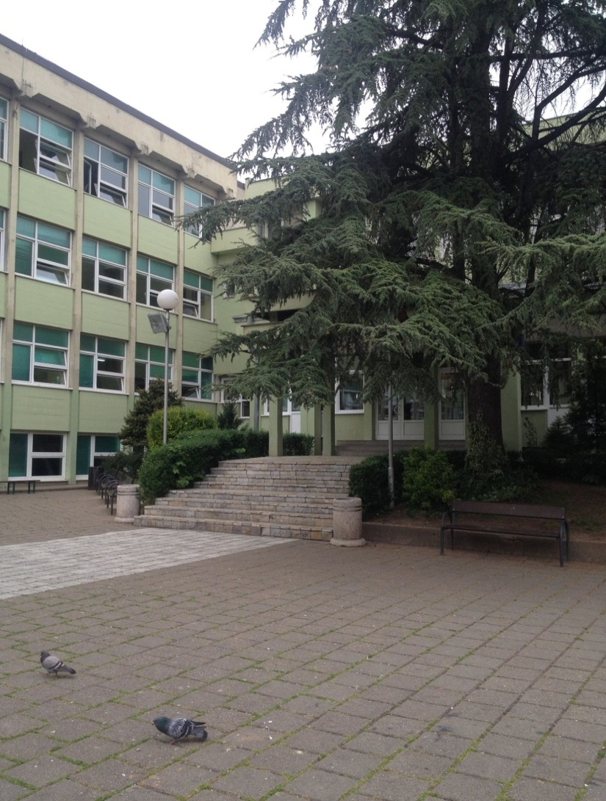
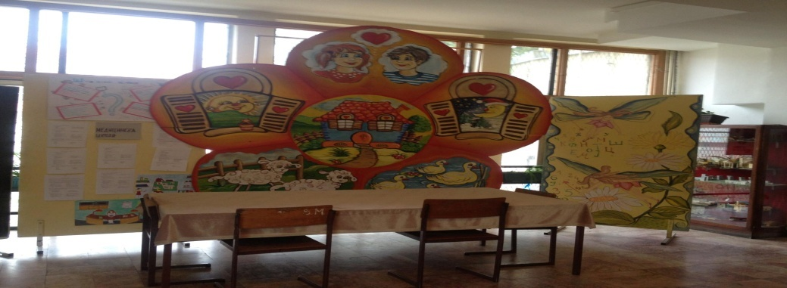
The entrance to the main school building
The main school building is where most of the staff offices are. The canteen is also located in this part of the school. The kids of lower grades eat there and that is where school meals are made. The school offers food to students every month. Of course you have to pay a monthly fee for that.
Art exhibitions are held in the school hall each month.

Slide 4
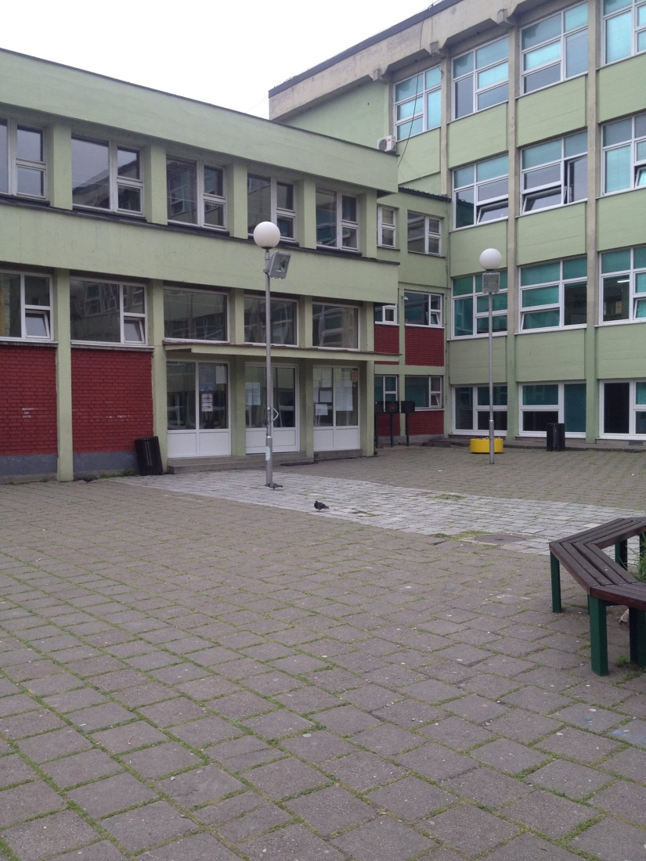
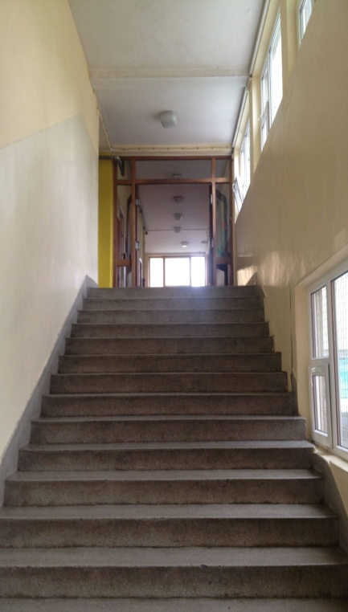
The second entrance to the school
The second entrance leads to the gym and other classrooms. Some of these classrooms are used only by the students of upper grades.
There is also an exit to another yard next to the gym. Most sports events are held either in the gym or in the small yard.
The Psychologist’s office is in this part of the school.

Slide 5
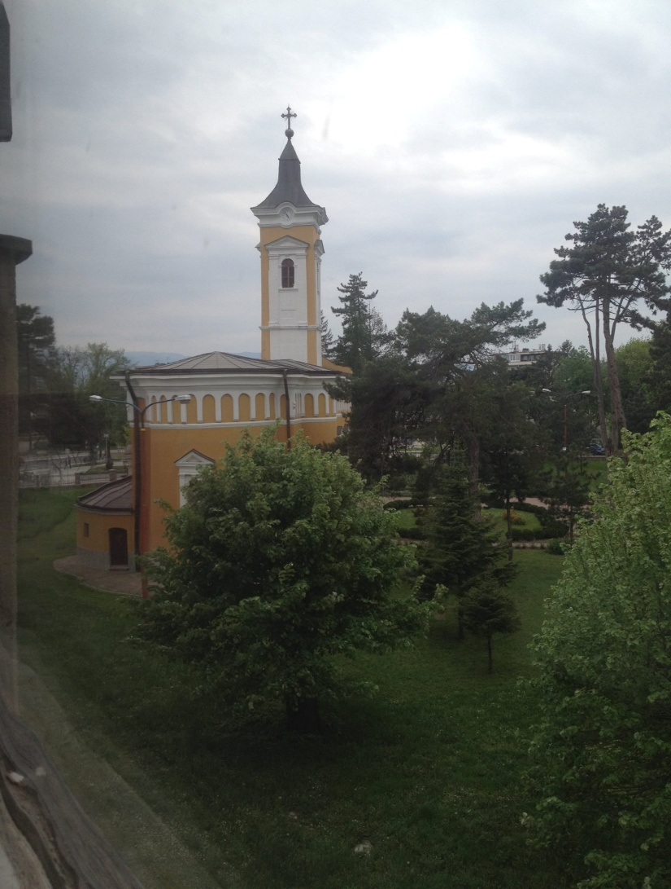
The church
Saint Trinity Church is an orthodox church. It is the oldest orthodox church in the area. It is right next to our school, and it is surrounded by beautiful trees and bushes. We can see it from most of the hall windows of our school.
We can also hear the bells sometimes. We often visit the church at our religious education classes. The photo has been taken from the second floor.

Slide 6
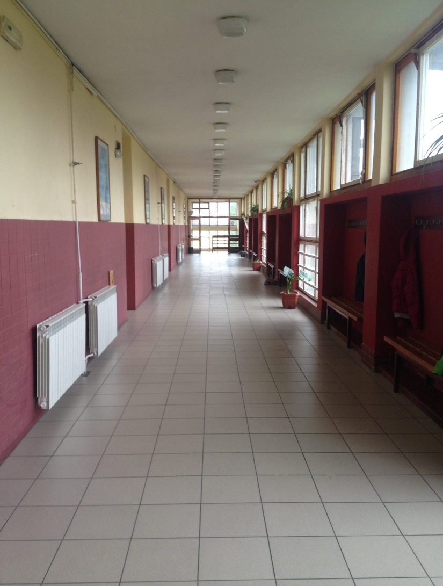
The halls and the classrooms
There are four floors at our school including the basement. Art , Craft, Chemistry and Physics classrooms are in the basement. The ground floor is only used by younger students, mostly those of the 3rd and 4th grade. The first floor is for History, Geography, Biology, German and Maths classrooms. The second floor has two classrooms for Serbian ,two classrooms for English, a Music and an IT classroom that has computers in it. All the classrooms are pleasant and equipped with modern furniture and teaching technology including smartboards.

Slide 7
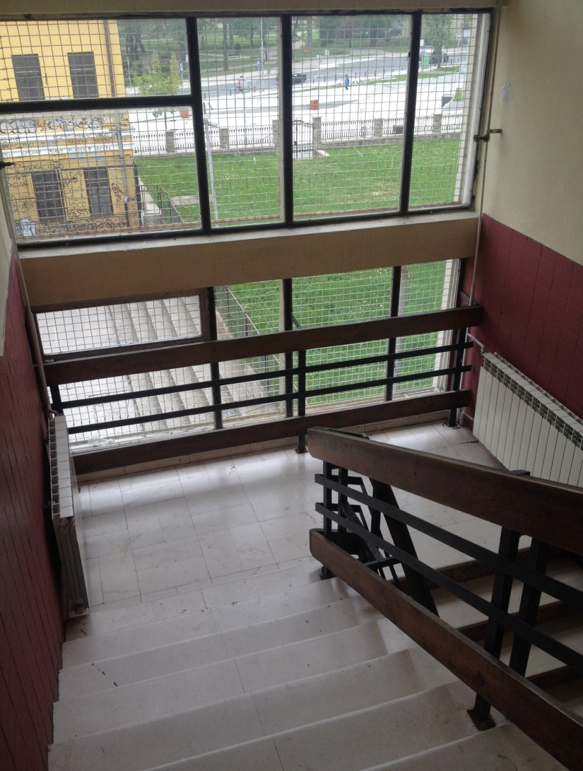
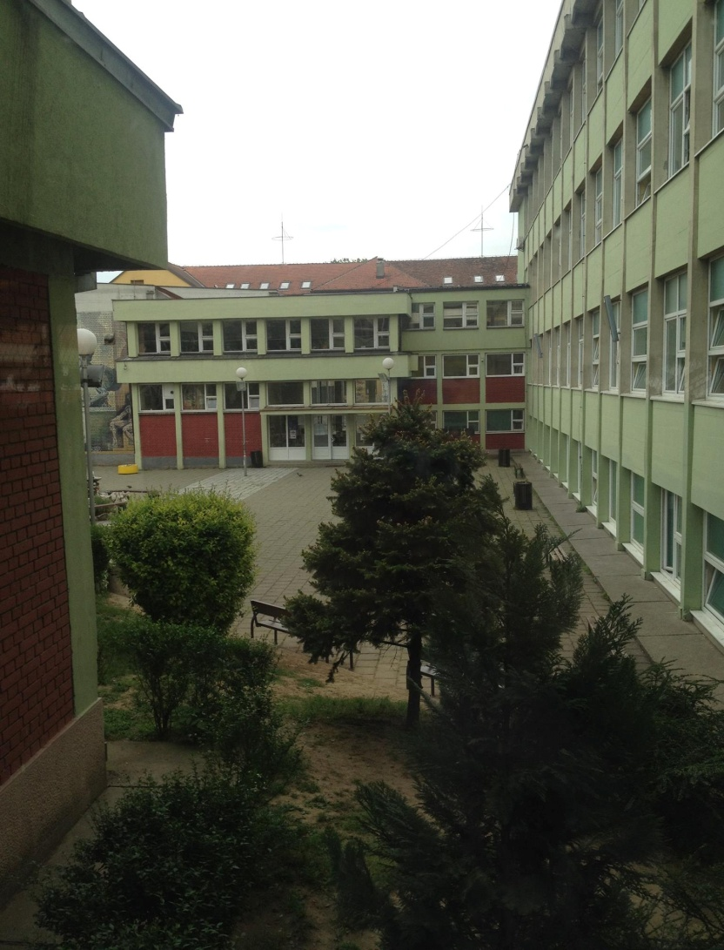
Stairs from the west wing of the school and the second entrance

Slide 8
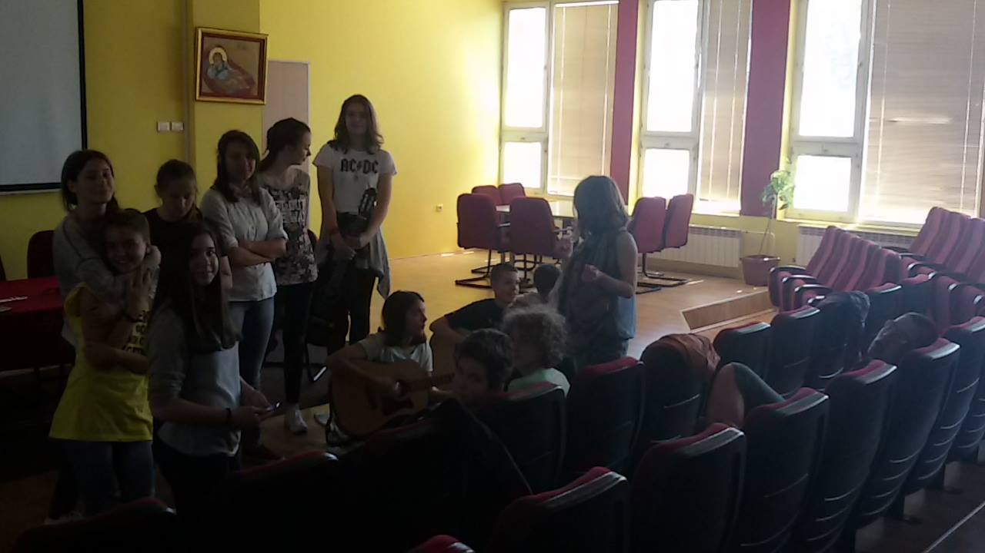
The school orchestra
This year our music teachers have decided to organize a school orchestra. There are four guitars, two violins, two trumpets and a lot of singers. We are practising for the end of the school year party. We are going to play some rock songs for many spectators. We are all impatient about the performance.

Slide 9
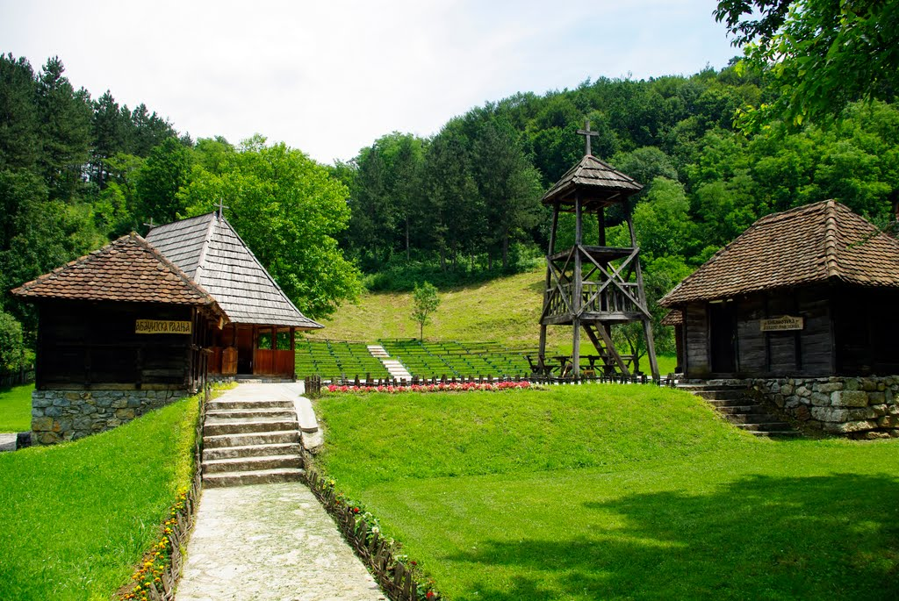
Trsic village
The students of the 8th grade had their last excursion in September. We went to three places. Trsic, Subotica and Novi Sad. Trsic is a small village with rich history. It is located near Loznica and it is famous because it is the birth place of the father of Serbian language and literature, Vuk Karadzic. Nobody lives there anymore. In 1993 it was rebuilt and two more buildings were built on the land. We enjoyed the walk by the river and the beautiful countryside.

Slide 10
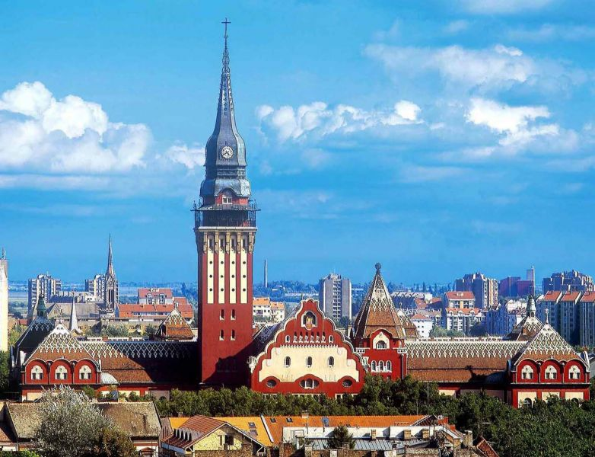
Subotica
We also went to the northern part of Serbia, where Subotica is. It is a very large town, one of the largest in Serbia. Close to it is lake Palic, which is a very popular tourist destination in Serbia. Because it is located so close to Hungary, many Hungarian people live in the town. There are also 17 villages in the region. We visited the City Hall and took photos of the Blue fountain. After that we went to the Palic Zoo which is one of the best in Serbia. We enjoyed our visit there.

Slide 11
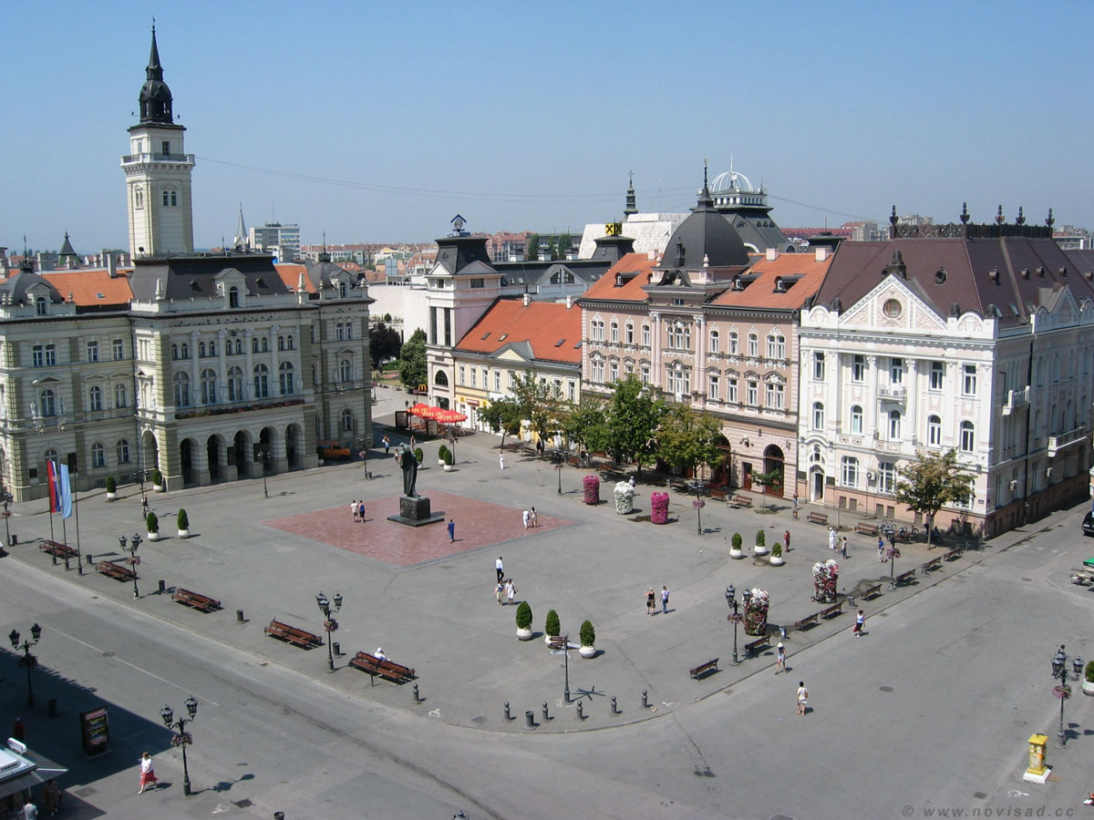
Novi Sad
Novi Sad is the second largest city in Serbia. It is located in the southern part of the Pannonia Plane, on the border of the Backa
and Srem regions, on the banks of the Danube river, facing the northern slopes of Fruska Gora mountain. Novi Sad is an important industrial and financial center of Serbian economy, as well as a major cultural center.The city was founded in 1694 by Serbian merchants. We stayed in the hotel Duga and visited the city centre.

Slide 12
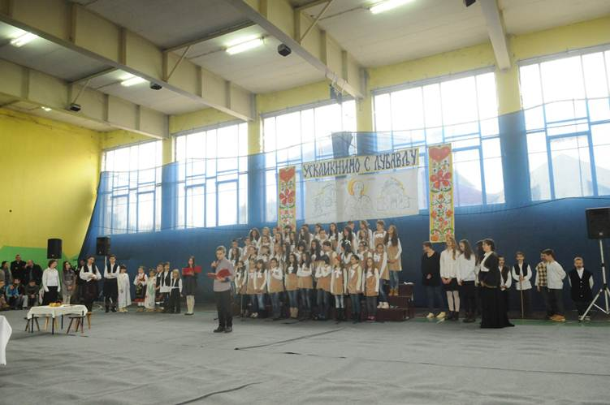
The Celebration of Saint Sava Day

Slide 13
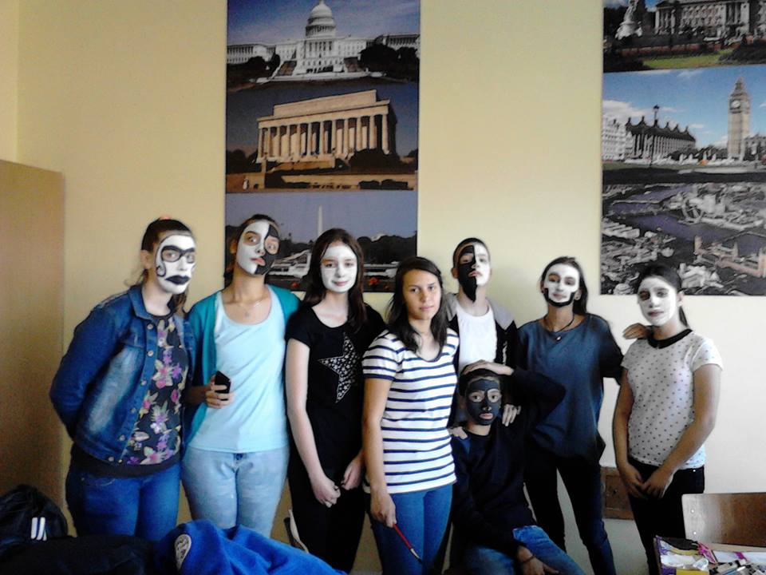
The mask ball
The mask ball was held at our school at the beginning of the school year. As you can see, we painted our faces black and white. It made us look like the members of Kiss. However, that wasn’t our intention. We had much fun making the masks. Our friend Ksenija was the main artist.

Slide 14
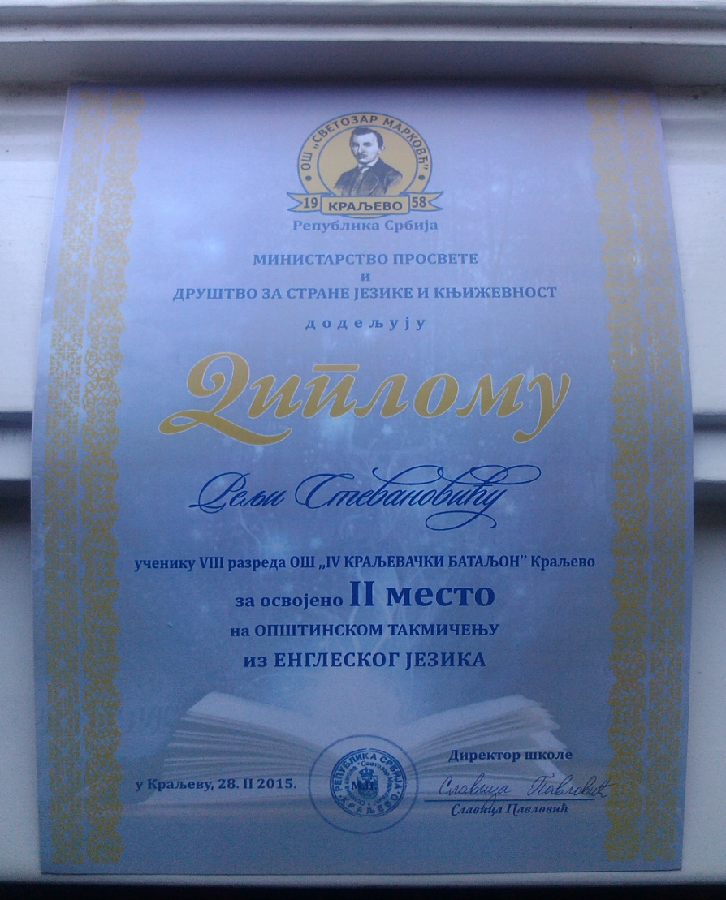
Diplomas and rewards
Many students from this school go to competitions in many subjects. We were really good at Maths, Serbian, English, Physics and Chemistry. Some
students even went to the national competitions and got rewards. We also took part in Cambridge selection competition and we are proud of our results.

Slide 15
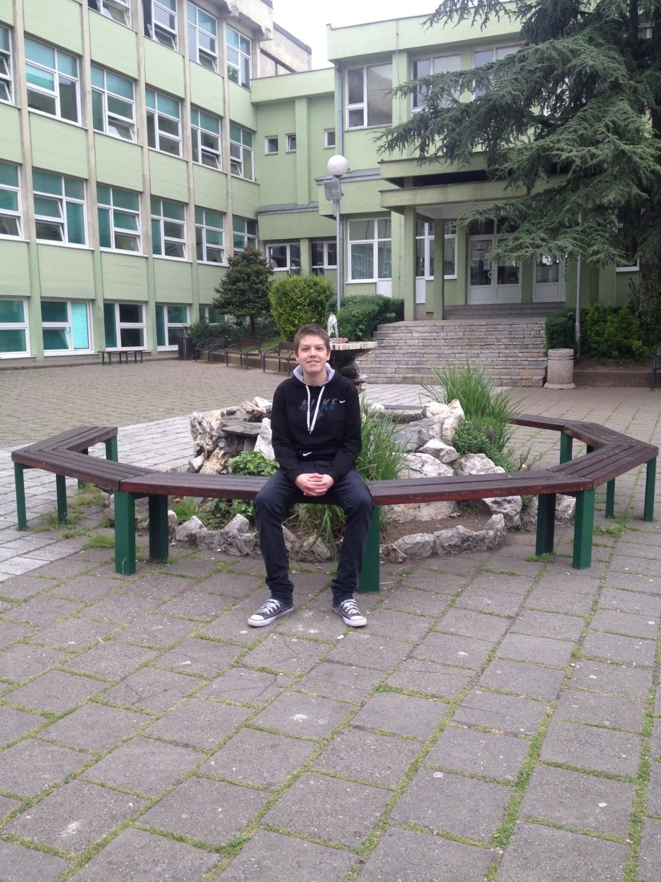
CREDITS
All in all, our school is a great place to spend time and study. Our teachers are great and we enjoy being the students of this school. We will always remember it with love.
Made by:
Relja Stevanovic
Aleksandar Dimitrijevic
Masa Vukobratov

